Slide 1
Computer Graphics HW4 : 3D Maze
Deadline: May 23, 2021

Slide 2
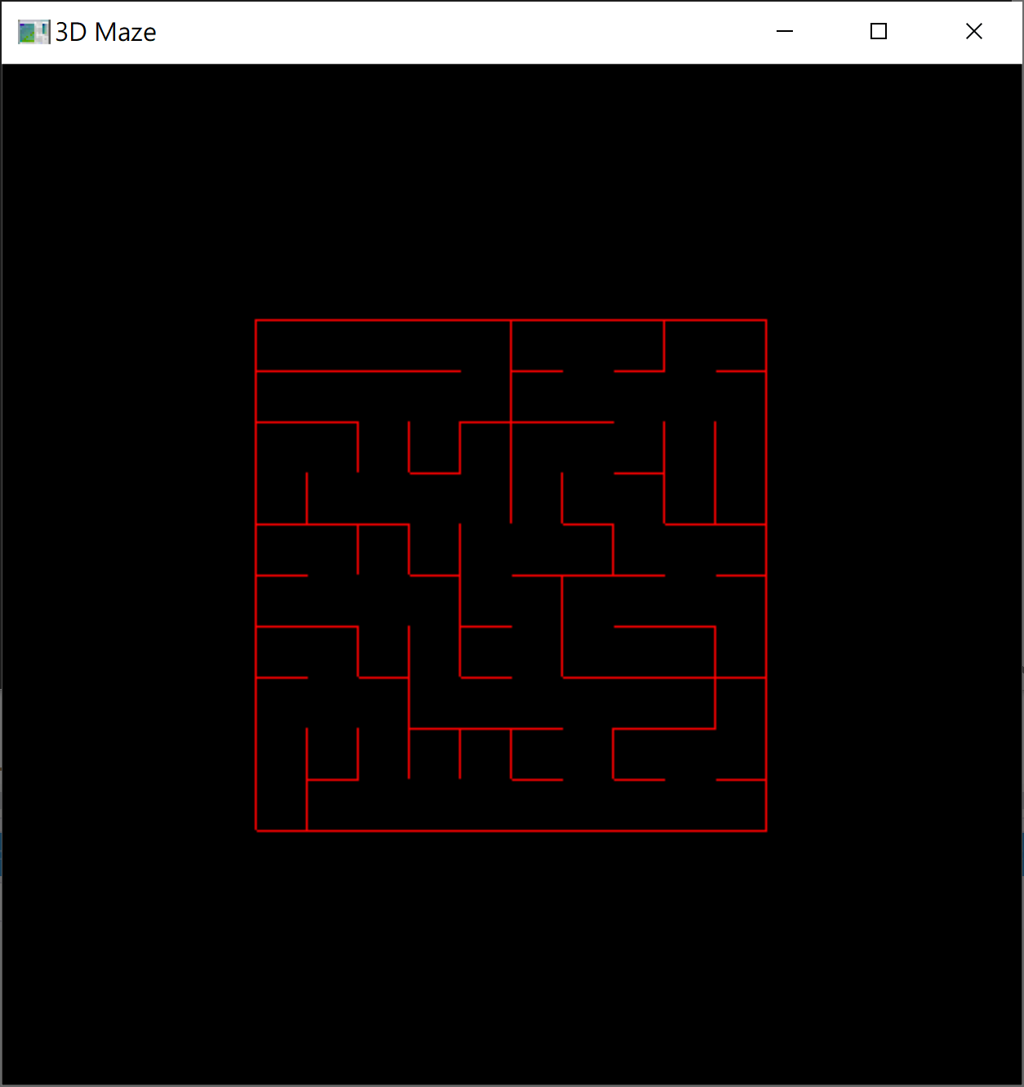
Requirement
3D Maze Construction
consider the 3D space as a rectangular array of cells with four sides.
remove the side until all the cells are connected except from the perimeter

Slide 3
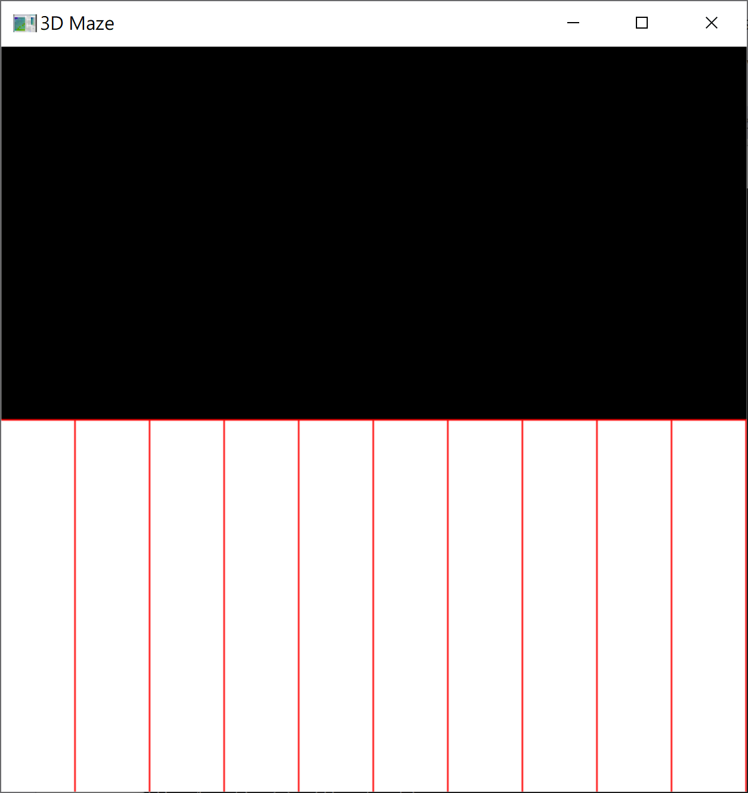
Requirement
3D Maze Viewing
The play can view the 3D maze from the first-person view (key: ‘f’).
To get a hint, the player can view the 3D maze from the bird-eye view (key: ‘b’)..

Slide 4
Requirement
Navigation Control
Initially, the user is located at the center of the top-left cell.
The player uses the mouse to control the user.
Middle Button: move the user forward
Right Button: turn the user 90 degrees to the right
Left Button: turn the user 90 degrees to the left

